Slide 1
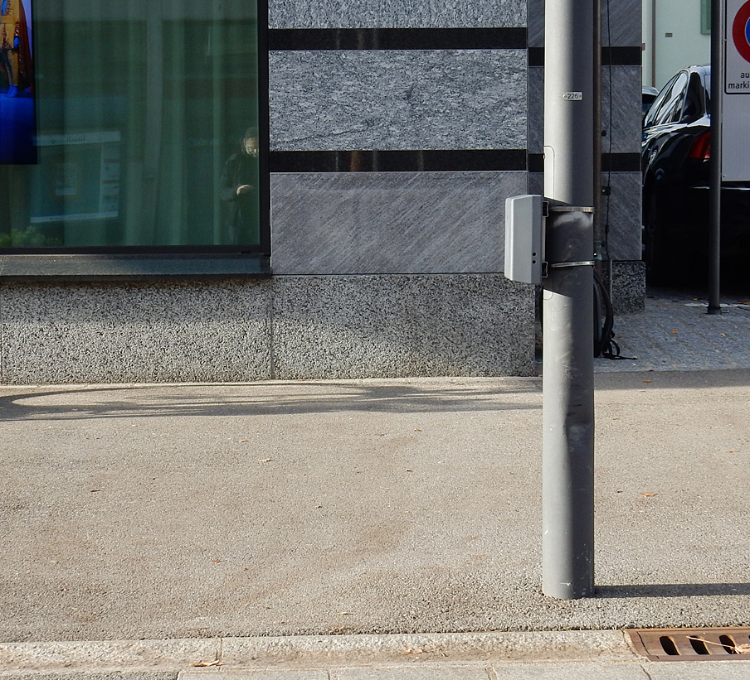
Walk Flow
By Justus, Oleg, Georg, Laurin
Powered by Daniel

Slide 2



(lots of) Data

Slide 3
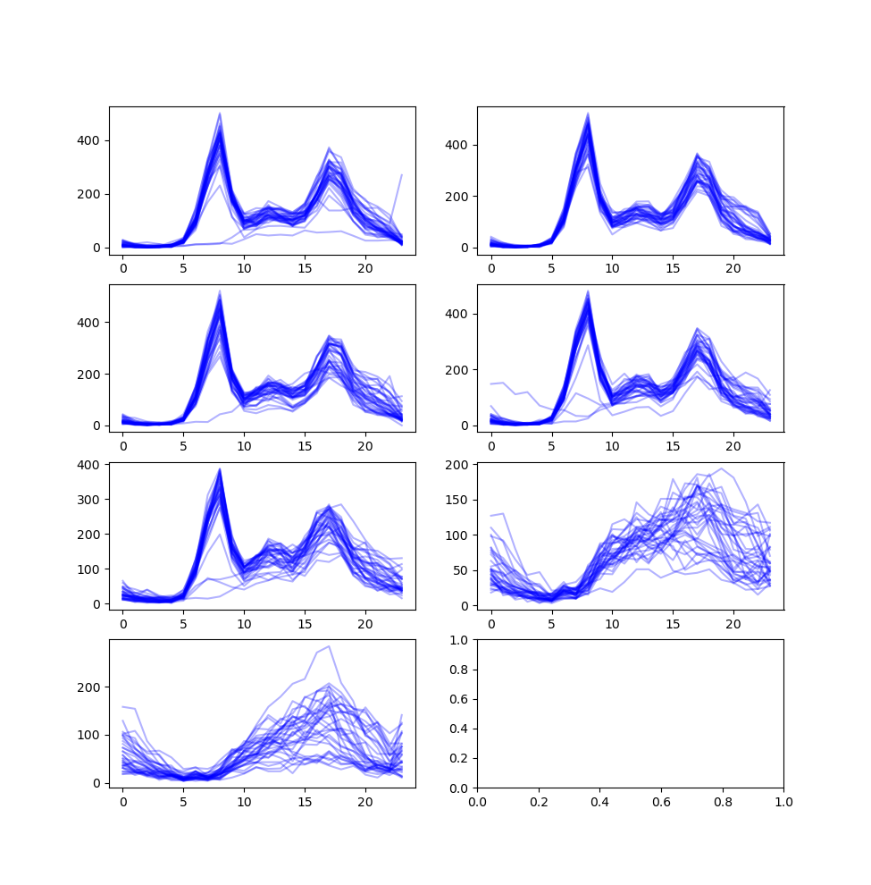
Dreirosenbrücke

Slide 4
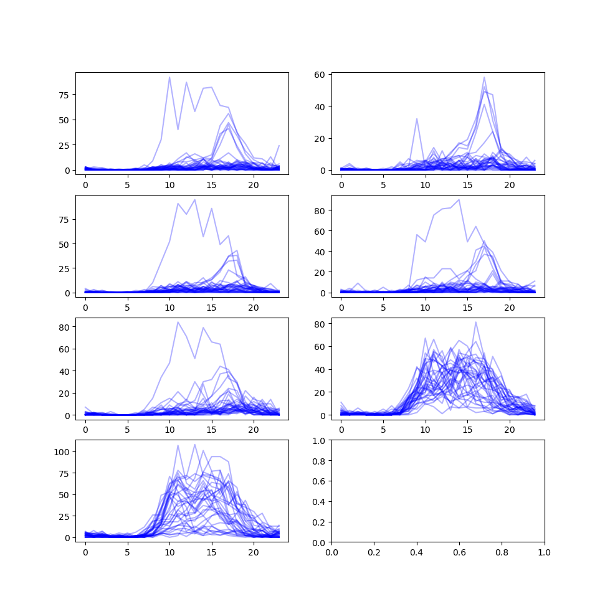
Elsässer-rheinweg

Slide 5
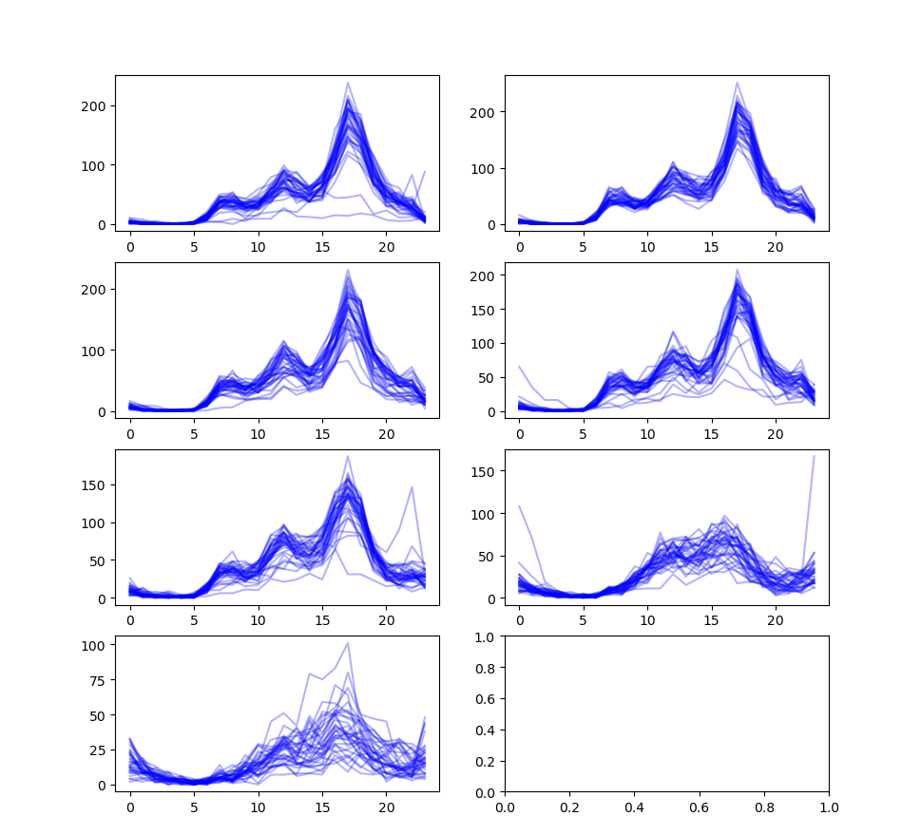
Leimen-strasse 4

Slide 6
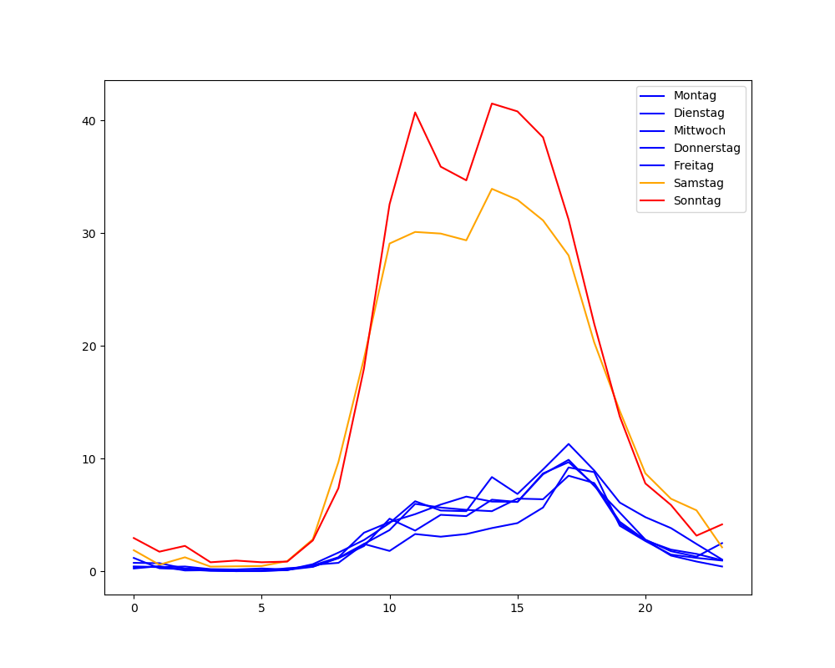
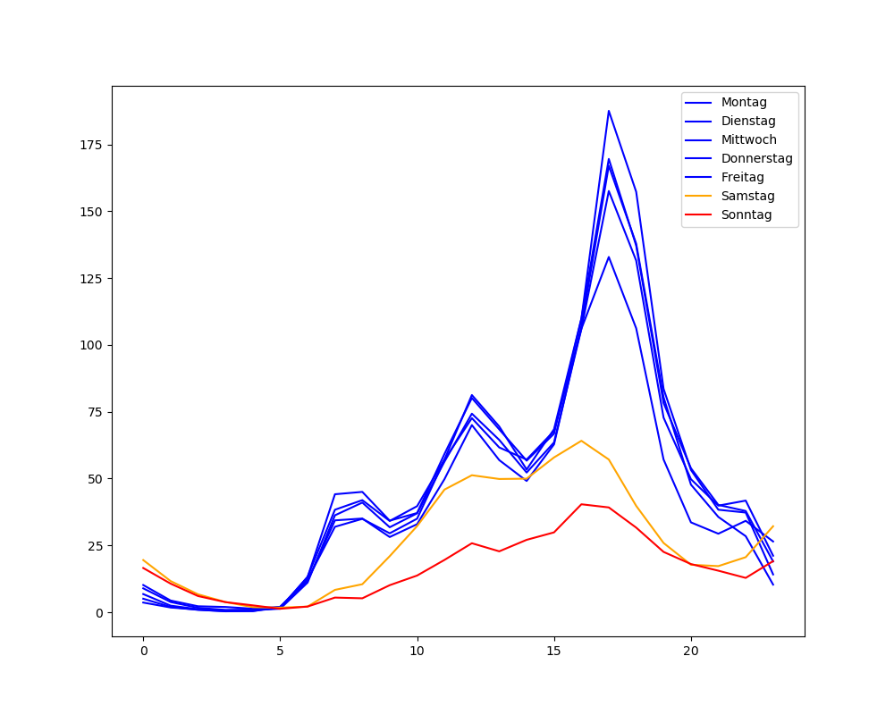
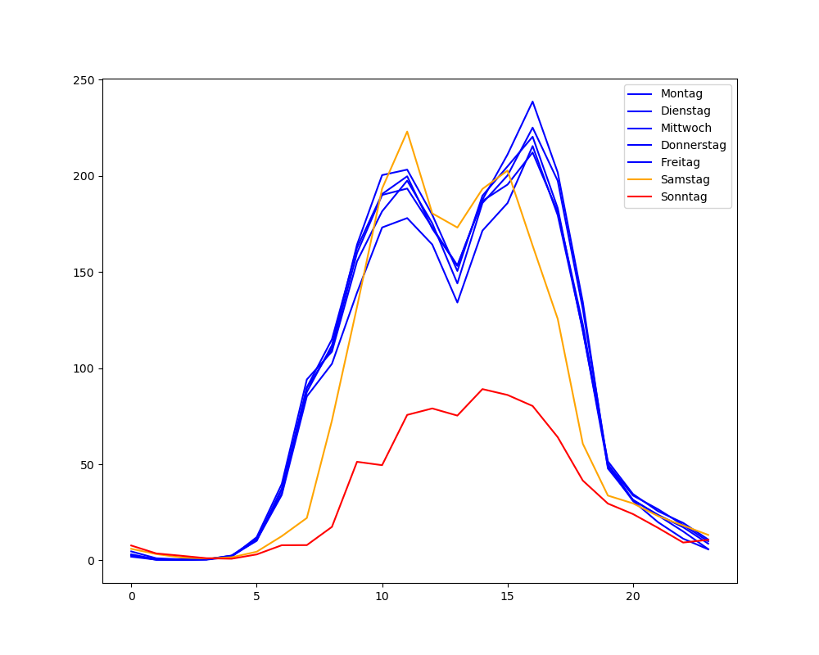
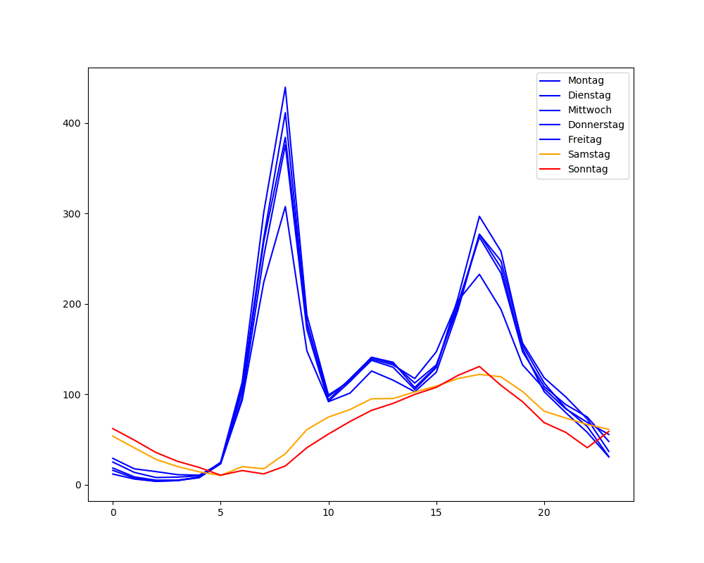
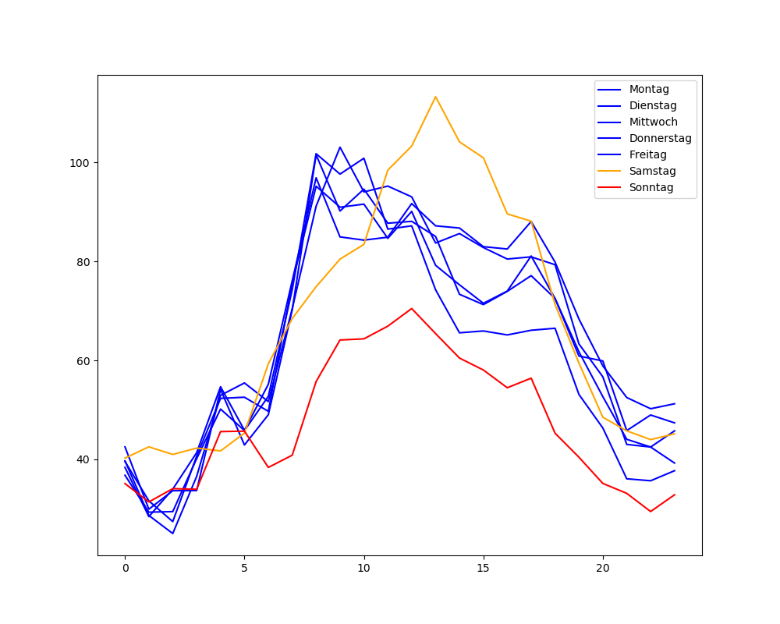

Slide 7
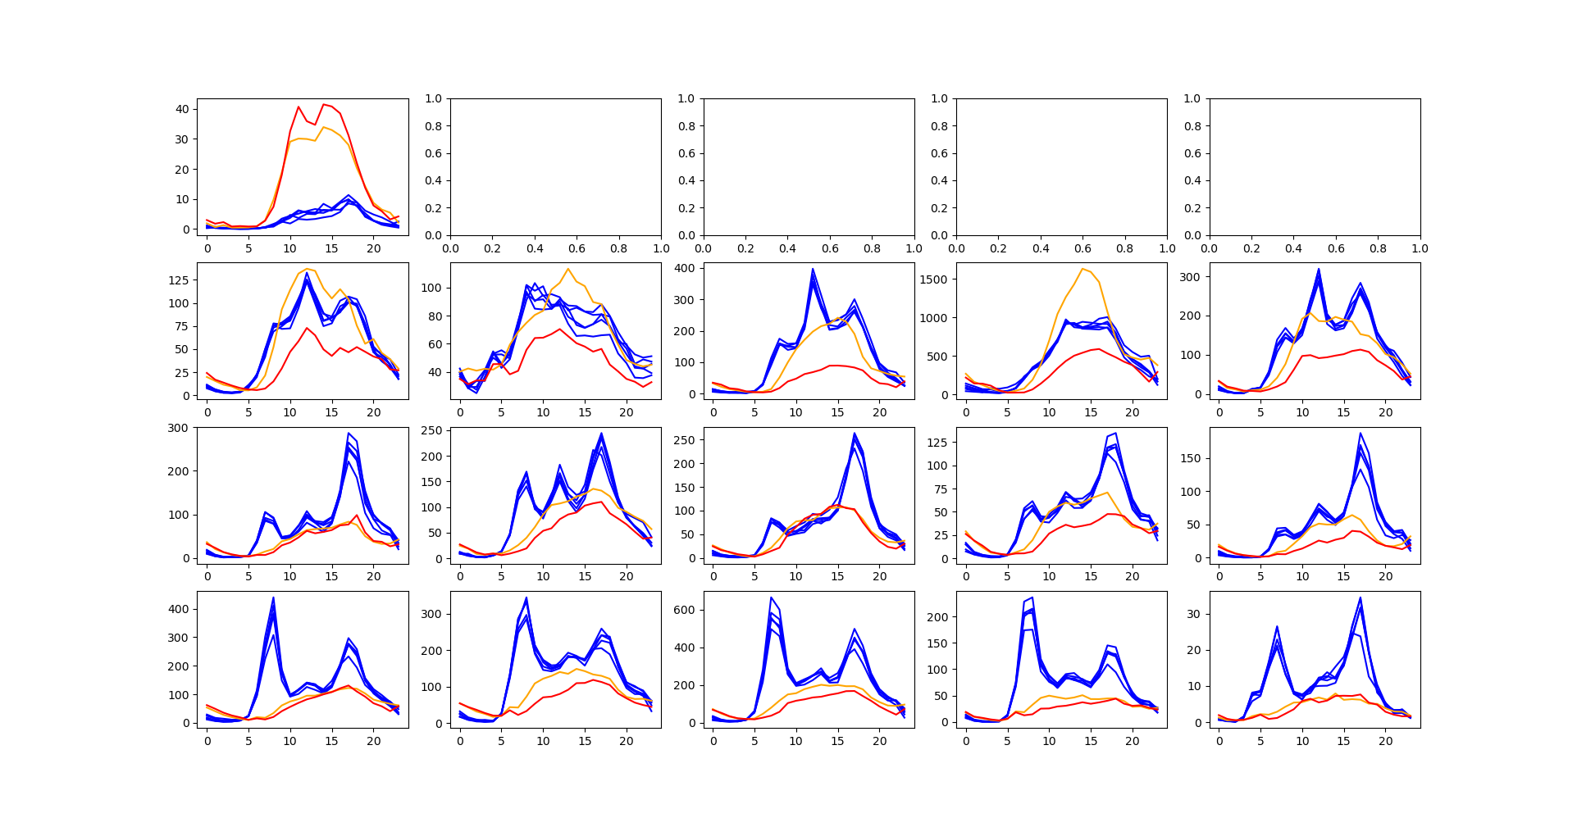
A
B
C
D

Slide 8
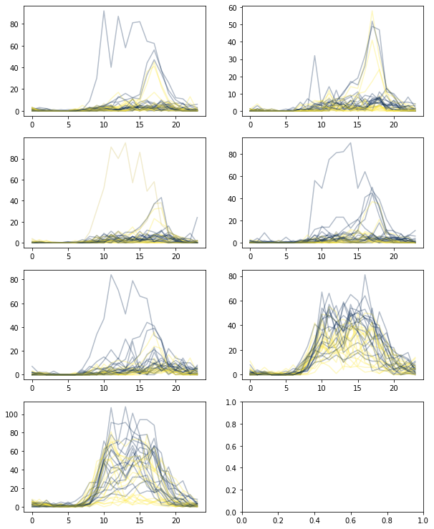
Wettereinfluss

Slide 9
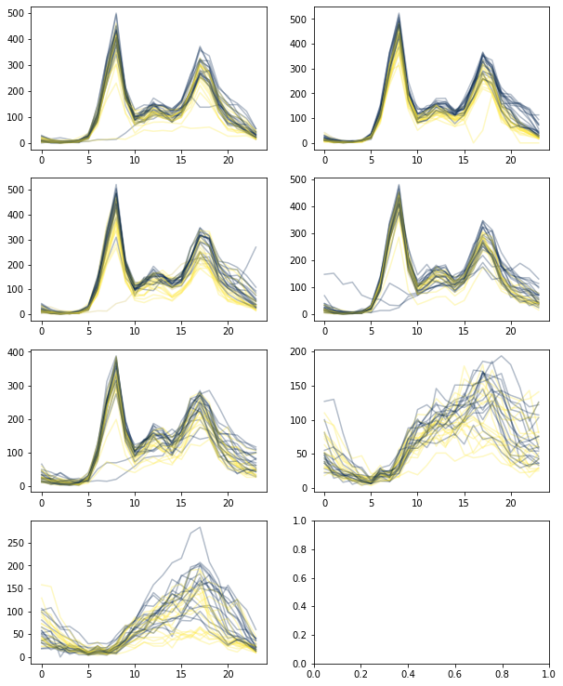
Wettereinfluss?

Slide 10
Demo
http://192.168.2.169:8080/

Slide 11
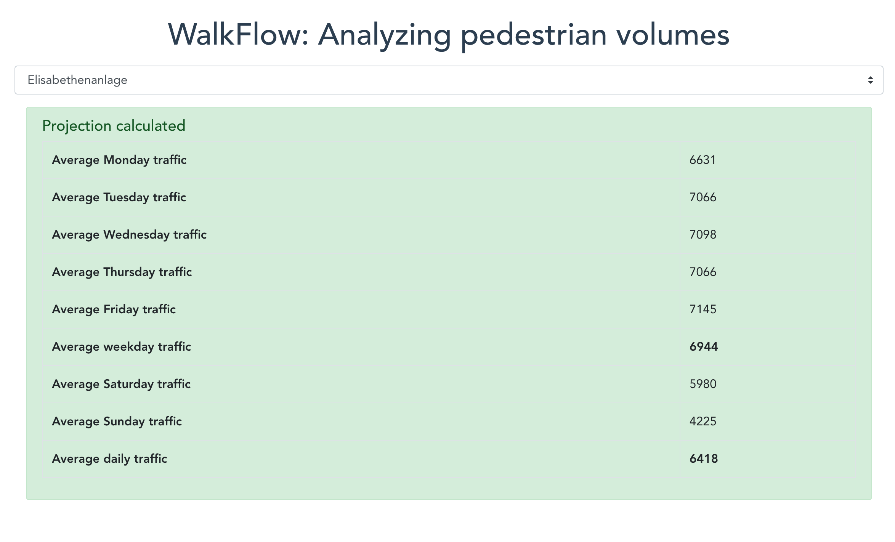

Slide 12

Next generation:
https://github.com/1b15/OpenDataHackdays19

